Slide 1

LJMU
Pre-departure Briefing

Slide 2
Checklist
Preparing to Travel
Arriving in the UK
Navigating LJMU System
Important Contact Information
Emergency Contacts
Agenda

Slide 3
Enrolment and Registration
Information about enrolment and registration will be sent by Academic Registry at the start of December or shortly after CAS issuance.
Registration will be made available around 1 August, with a step-by-step guide.

Slide 4
Checklist
Complete Enrolment and Registration
Confirm Accommodation
Check what permits you need to enter the UK
Complete induction signup form
Book flights
Arrange transfer to Liverpool - Airport Arrival Pickup service
Pay your deposit of 50% tuition fees

Slide 5
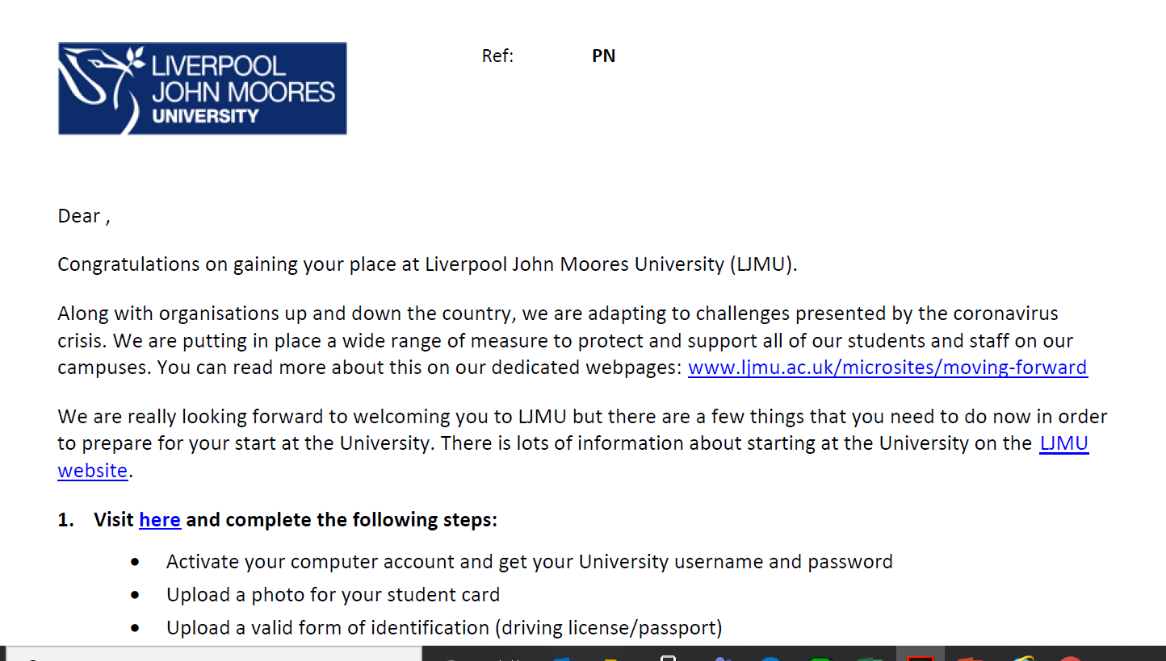
5

Slide 6
Registration Steps
You will need your student ID No. (6 numbers either starting with an 8, 9, or 10)
Your student ID No. is PN100000 (this is on your CAS and at the top of the registration email)
Activate your computer account and get your LJMU username (username@ljmu.ac.uk ) and password- (Please write this down it will not be emailed to you)
Upload a photo for your student card
Upload a valid form of identification (passport)
Complete your online student registration

Slide 7
There should be no ‘dot’ in your username
Registration has 11 parts
Once completed you will get a confirmation
Top Tips

Slide 8
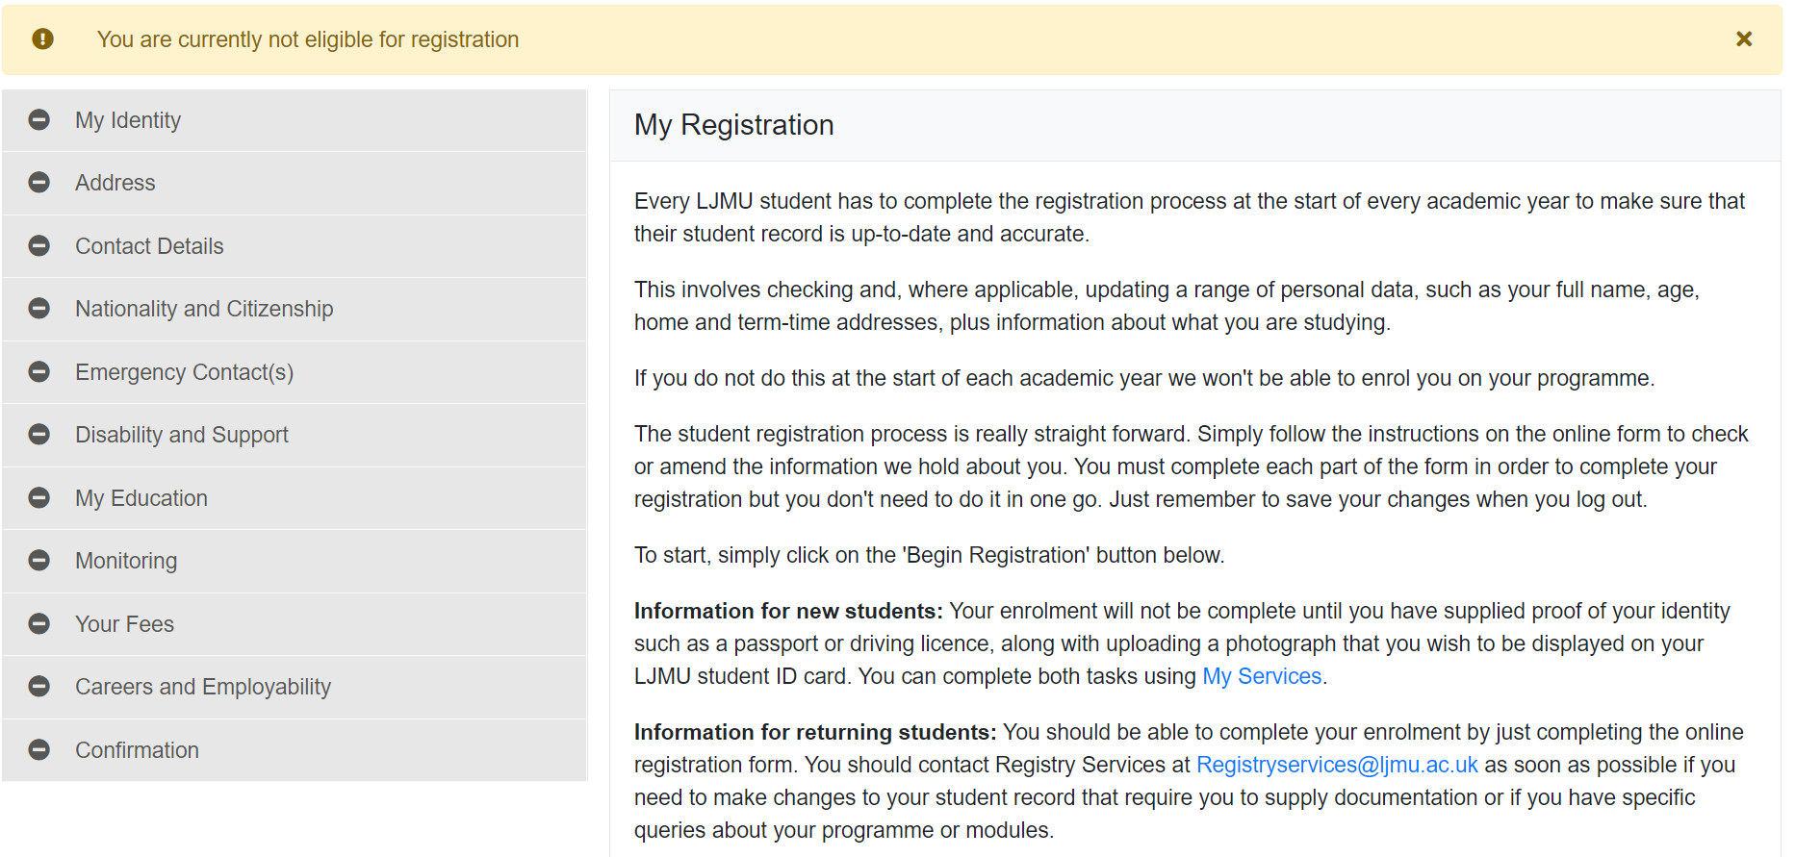
8

Slide 9
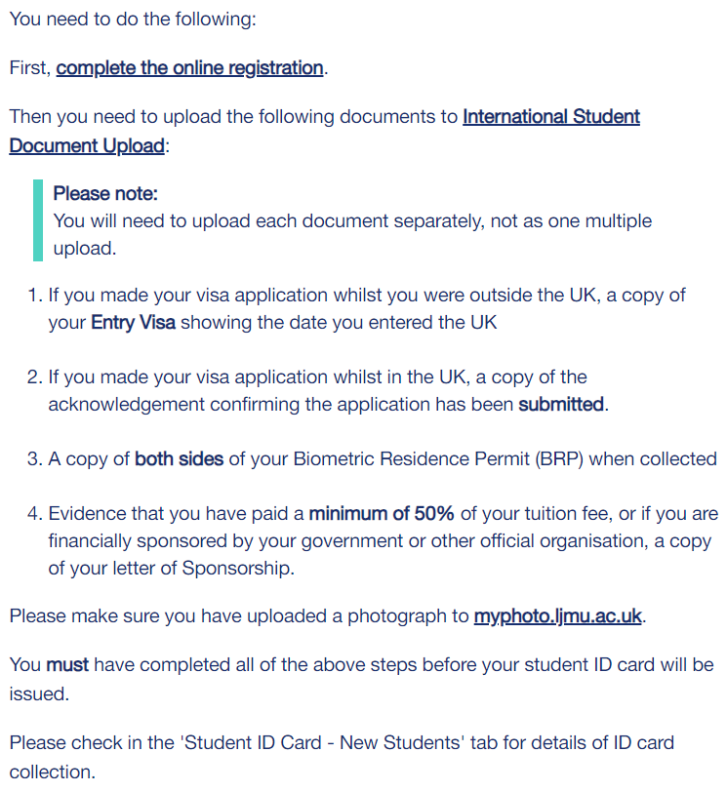
International Enrolment
Non-EU Students

Slide 10
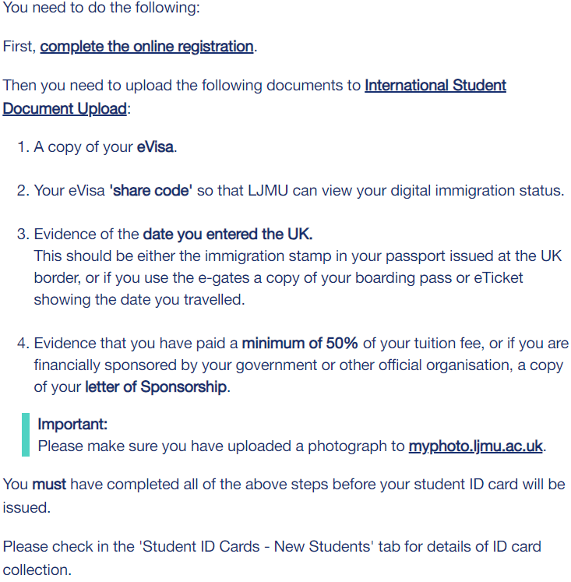
International Enrolment (EU)
EU Students

Slide 11
Registration Problems
If you are having any difficulty completing your student registration, please contact Student Registry registrationdocuments@ljmu.ac.uk

Slide 12
Collect your Student ID Card
Please note in order to collect your student ID card, you will need to have done the following:
Paid at least 50% of your fees by 8th January
Completed Registration and
Online Enrolment
ID Cards can be collected between 9 and 26 January 2024.
Exact rooms can be found on the International Induction | Liverpool John Moores University

Slide 13
Preparing to travel

Slide 14


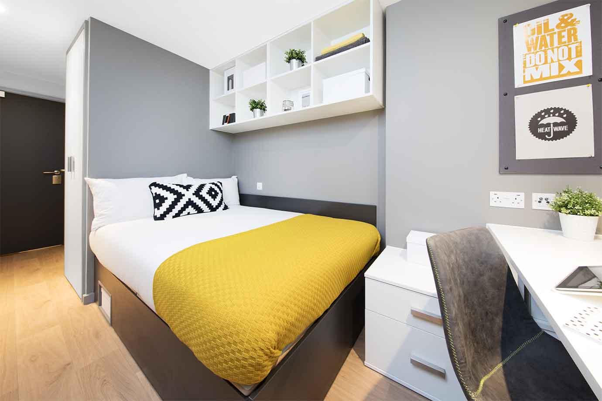
Confirm Accommodation
https://www.ljmu.ac.uk/discover/your-student-experience/accommodation

Slide 15
Accommodation
Contact: accommodation@ljmu.ac.uk
If you will be living in LJMU Accommodation, you will be able to move into accommodation from Saturday 6 January 2024:
https://www.ljmu.ac.uk/forms/accommodation-request-form
https://www.ljmu.ac.uk/discover/your-student-experience/accommodation/january-start-students
Liverpool Student Homes: https://www.liverpoolstudenthomes.org/Accommodation
*Please note you must be living within 1 hour of Liverpool to comply with UKVI policies

Slide 16
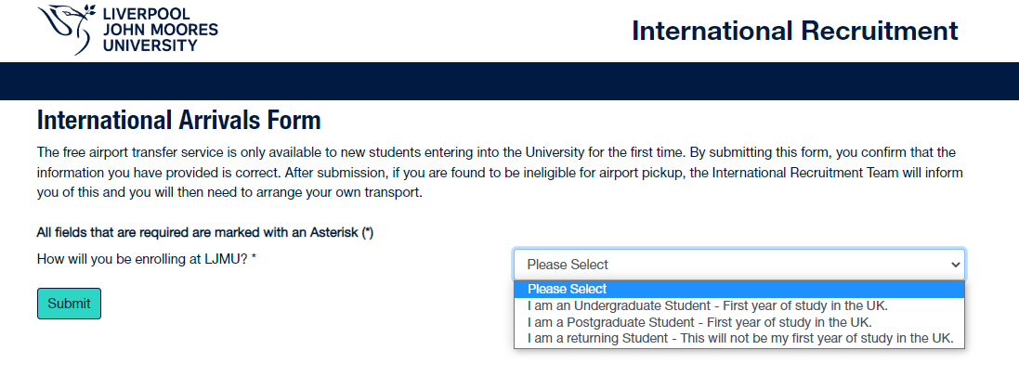
Book Airport Pick up
Services are only available to the following postcodes:
L1 – L8
L13 – L15
L17 – L19

Slide 17
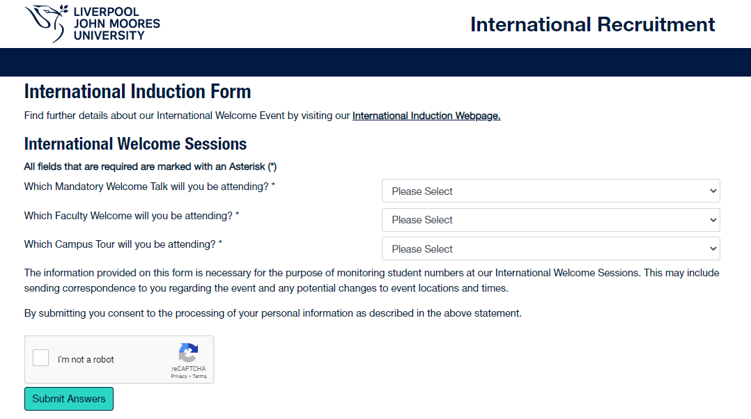
International Induction – 9th and 15th of January

Slide 18
Airports
London Heathrow – 3 hr 42 mins by train (~£60 single ticket)
– 3 hr 30 mins by taxi (~£267)
London Gatwick – 3 hr 12 mins by train (~£73 single ticket)
– 4 hr 50 mins by taxi (~£299)
Birmingham Airport – 2 hr 14 mins by train (~£30 single ticket)
– 4 hr 50 mins by taxi (~£299)
Manchester Airport – 1 hr 13 mins by train (~£10 single ticket)
– 50 mins by taxi (free if booked through LJMU)
Liverpool Airport – 30 mins by train (~£3.75 single ticket)
– 30 mins by taxi (free if booked through LJMU)
Free transfers are not available for exchange students

Slide 19


Booking train tickets
Things to note when travelling by train:
The trainline app is really useful for booking train tickets
Increase in price if needing to reschedule or rebook a train due to flight delays
Look at flexible tickets (you can leave the station at the same time every hour)

Slide 20
Your luggage
What to bring hand luggage
What to bring checked luggage
What NOT to bring
Official documents (Passports, visas)
A change of clothes
Small amount of local currency ~£500
Mementos
Passport photos
Adapters
Phone and charger
Headphones
Tissues
Raincoat/umbrella
Mask
Bank account details
Clothing (weather appropriate)
Shoes
Toiletries
Medication
Sheets or bedlinen
Towels
Liquids over 100ml in hand luggage
Cooking equipment
Food items such as grains, rice, pickles and fruit
Frozen or cooked food
Appliances such as hairdryers that use 110v current (UK plugs run at 230v so could blow the fuse)

Slide 21
Travel Tips
Keep your luggage with you at all times
Keep money and valuable belongings such as laptops and iPads out of sight
Do not leave your luggage unattended – it will be considered a security threat and will be removed by airport security, causing you significant delays.
Do not look after luggage/parcels for strangers or allow strangers to look after your belongings
Do not carry an item through airport customs for someone else
Do not accompany people you have only just met to places you do not know
Only use taxis from an official taxi rank. These taxis are licensed and insured to carry paying passengers. Taxi ranks are usually located near the entrance/exit of airports and railway stations

Slide 22
LJMU is Cashless
LJMU is a cashless university
Please do not carry cash in order to pay your tuition fees, accommodation etc.

Slide 23
Exchange Students
All information relating to Exchange can be found here
Learning Agreements and module choice via your designated International Mobility Coordinator (IMC). Reach out to them if you need anything
All IMC’s will arrange a personal meet up with their exchange students and will complete any Erasmus or other documentation then
Any queries contact goabroad@ljmu.ac.uk

Slide 24
Arriving in the UK

Slide 25

25
Welcome to Liverpool

Slide 26
Setting up a bank account
Check to see if your bank has a UK branch as they can give reduced fees for international transfers.
Check international transfer fees before sending any money to and from home.
Where is the nearest UK branch located?
Nationwide, for example, allows international students to set up a student account and doesn’t charge transfer fees.
Shop around and find the best deal that works for you.

Slide 27
Bank account
Go to my.ljmu.ac.uk
Click on My Services
Request Letter – must be enrolled to request
Check with the bank what additional documents they may require
*This can be done a maximum of 3 times

Slide 28
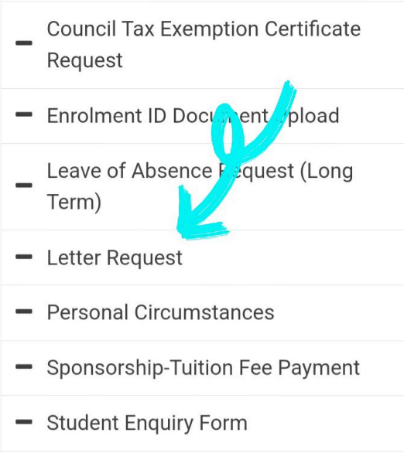
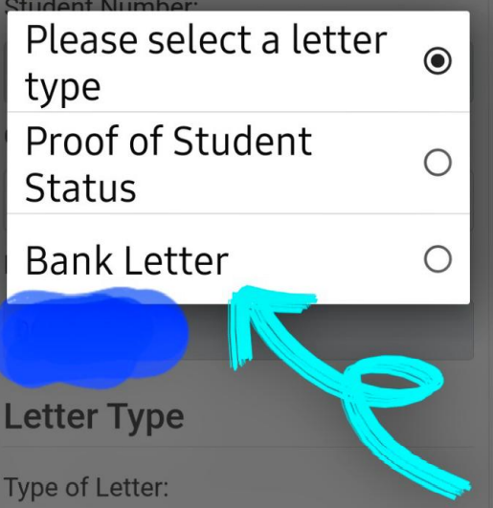
Requesting a Bank Letter.
Go to the ‘Letter Request’ option, check your details are correct and then select ‘Bank Letter’. You will be emailed a copy to your LJMU email once it has been created.

Slide 29
BRP Collection
Please collect your BRP from the post office – the postcode in the city centre is L1 8BN
Check that the information on the card is correct and covers the duration of your studies. If incorrect, get in touch with the team on internationaladvice@ljmu.ac.uk
Email a copy of the documents to studentregistration@ljmu.ac.uk

Slide 30
GP Registration
Register with a GP (general practitioner/doctor) as soon as you can after moving to Liverpool.
Most LJMU students register at Brownlow Health Medical Centre: https://central.brownlowhealth.co.uk/register/

Slide 31
Budget
 | Cost per month | Things to note
Accommodation | £400+ | University provided accommodation starts at £89 per week
Food | £100 + | If cooking, otherwise budget more for dining out
Mobile phone plan | £10+ | Depending on provider
Leisure and Entertainment | £50+ | Remember to make use of student discounts
Transport | £60+ | If staying in university provided accommodation, you shouldn’t need a weekly ticket
Laundry Costs | £20+ | May be included in your rentals

Slide 32
LJMU Systems & Services

Slide 33
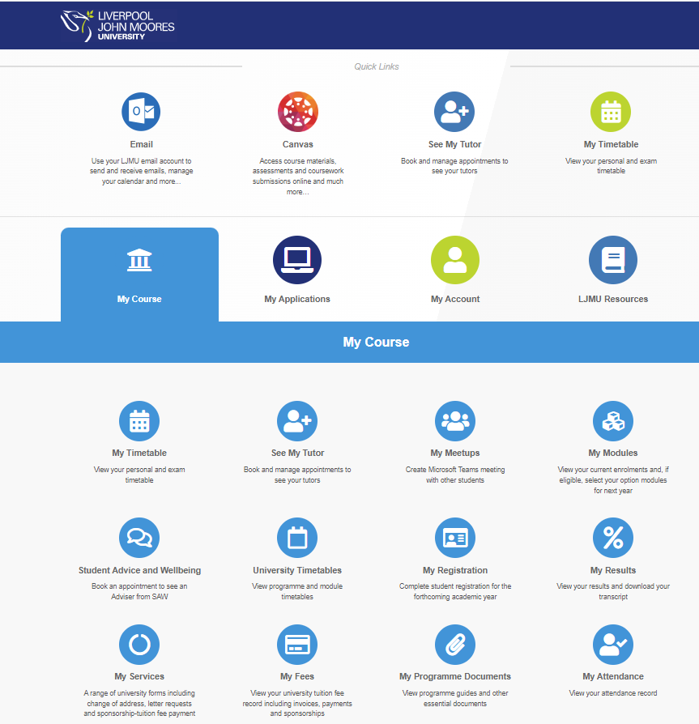
My LJMU- https://my.ljmu.ac.uk/

Slide 34
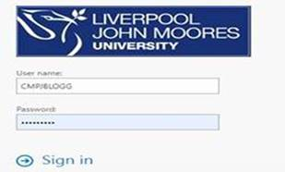
Troubleshooting
If logging into your LJMU email (outlook) then use your 8-letter username, for example CMPJBLOGG (see below) and password

Slide 35
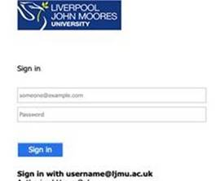
If logging into MyLJMU, My Registration or Canvas you will use the 8-letter username with the @ljmu.ac.uk as your user ID, so for example CMPJBLOGG@ljmu.ac.uk

Slide 36
To reset your password:
https://myaccount.ljmu.ac.uk/ForgotPwd.aspx

Slide 37
Canvas
Canvas is LJMU’s Virtual Learning Environment: https://www.ljmu.ac.uk/students/before-you-arrive/canvas
It takes 48 hours for modules to show on Canvas after registration has been completed.
Canvas has its own help menu in the left menu
Canvas App is available on Apple store/Google store
Notes:
Add Canvas app screenshot

Slide 38
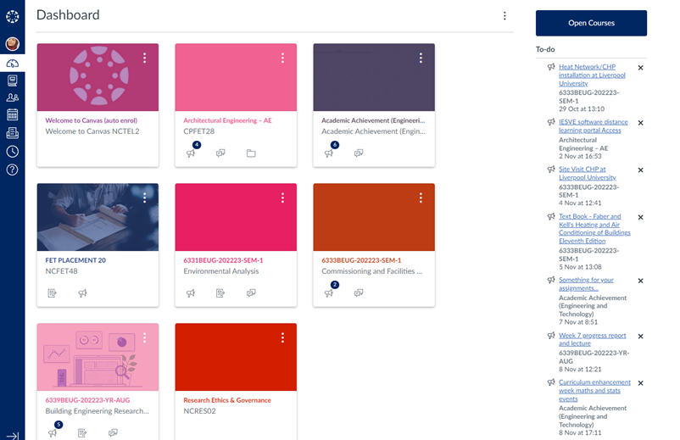
Canvas: Top Tips
This is what Canvas looks like when you first open it – it shows the modules in your course, any announcements your tutors have sent and your to-do list

Slide 39
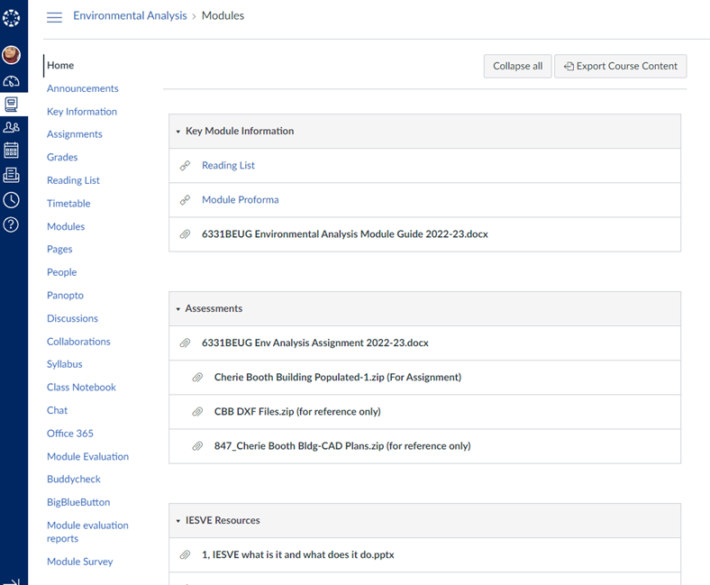
Canvas: Top Tips.
When you select a module, you can usually see the module guide, assessment briefs and other key information on the Home tab
Please note: every course tutor
will lay out Canvas slightly
differently

Slide 40
Canvas: Top Tips,
Key tabs within a module on Canvas include:
Reading List – where your lecturers will post content to support your assignments
People – where you will find tutor information and the names of your classmates
Panopto – lecturers will sometimes post tutorials/solutions for things like software you may use in your course
Timetable – this should link to your timetable alongside it being available in MyLJMU. Timetable will be made available from 7 September.

Slide 41
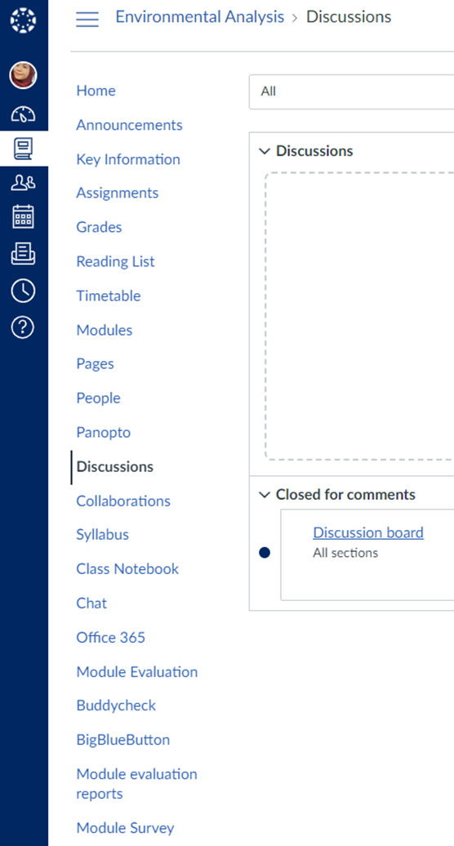
Canvas: Top Tips\
The Discussions tab allows you
to publish any questions you have
for your lecturer and classmates
to discuss
You can also use the Inbox
function to chat directly
with your tutors

Slide 42
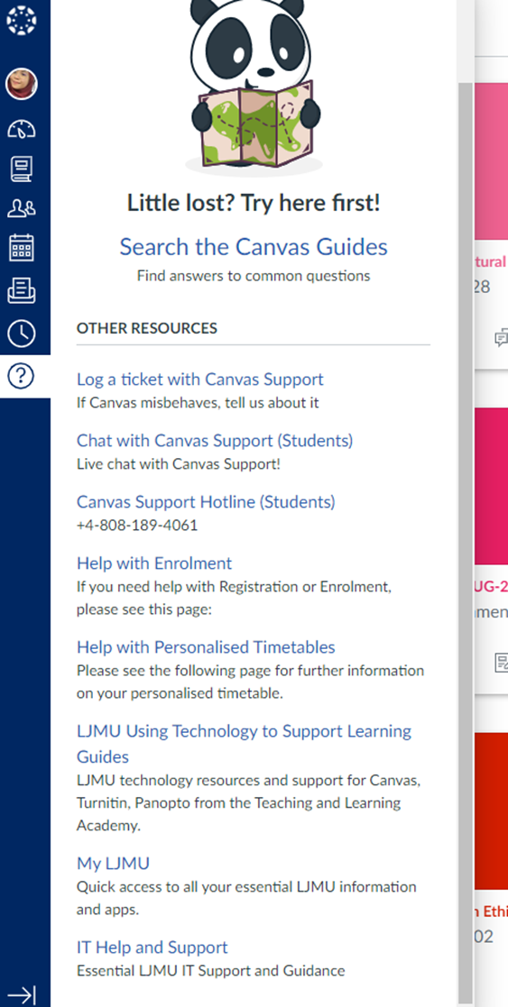
Canvas: Top Tips!
If you need help with Canvas,
there is a tab on the left which
shows you guides and other
aspects of your studies

Slide 43
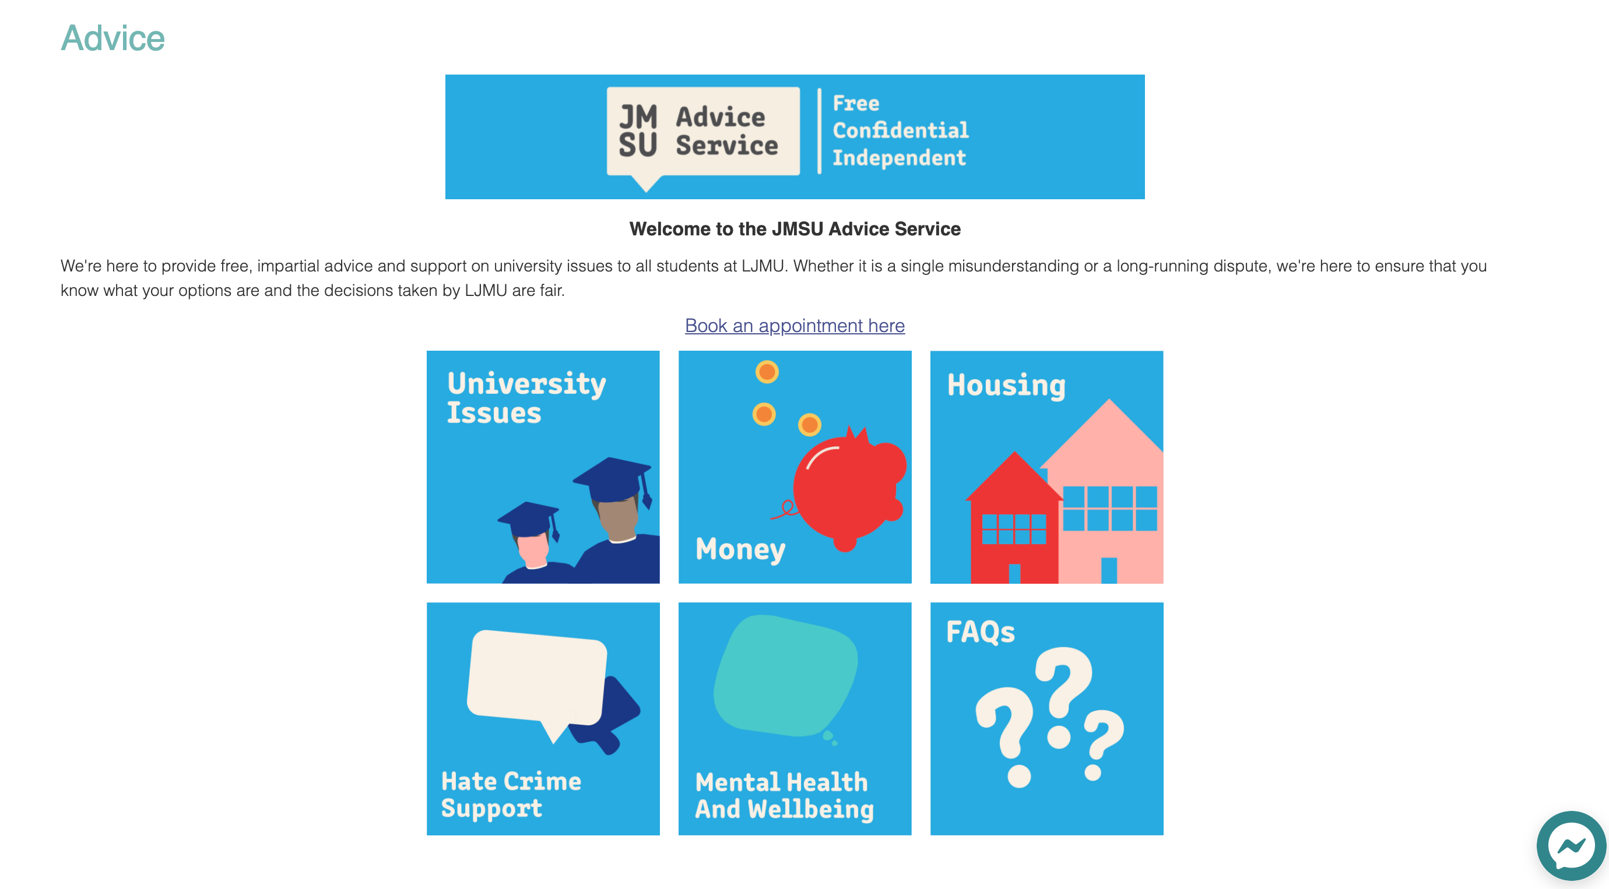
Student Union
https://www.jmsu.co.uk/

Slide 44
Student Advice & Wellbeing
If you need support, our dedicated Student Advice and Wellbeing Services team are on hand to help
They offer virtual & in-person appointments, or drop in to visit them on Tuesdays and Thursdays 10am – 4pm in the Student Life Building, Ground Floor
Appointments can be made via MyLJMU
https://www.ljmu.ac.uk/discover/student-support

Slide 45
Academic Achievement
The Academic Achievement Team offers advice on studying at university – such as how to write great assignments, referencing and dissertation support.
They run classes regularly online and face to face in SLB throughout the year for topics like using statistics and doing research.
https://www.ljmu.ac.uk/microsites/library/academic-achievement

Slide 46
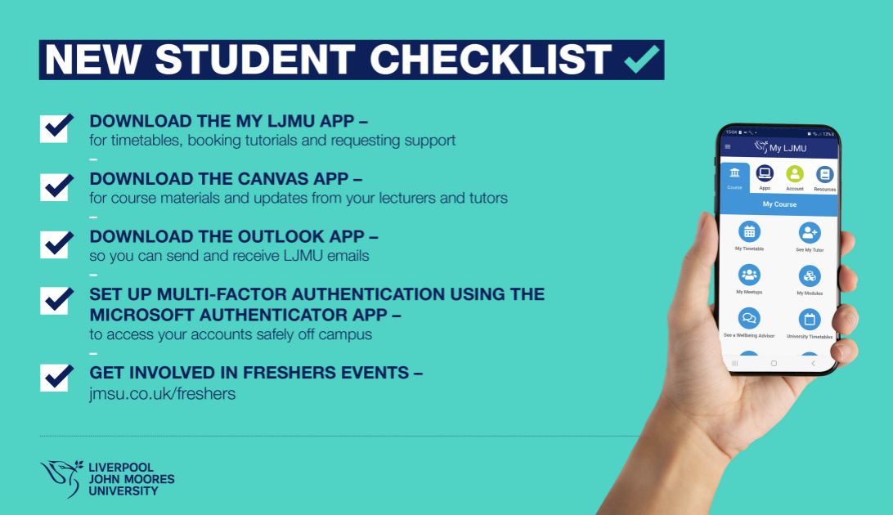
Final Checklist

Slide 47
Important Dates
8 January - 50% of fees due to collect student ID
9 and 15 January - International Induction
Teaching starts:
10 January - LLM International Business Corporate and Finance Law
15 January - Engineering and Science programmes

Slide 48
Emergency Contacts
Contact LJMU Security 24/7 for assistance, advice or to report a crime:
Emergencies: 0151 231 2222 (Internal 2222)
Security Control non emergencies: 0151 231 2083 / 2513

Slide 49
Contacts
General Enquiries
international@ljmu.ac.uk
Travel & Arrival Enquiries
internationalarrivals@ljmu.ac.uk
Admission & Application Enquiries
internationaladmissions@ljmu.ac.uk

Slide 50
Thank you!
Our International Student Ambassadors will be available over the Campus Connect app to answer any questions you have following the session.

