Slide 1
training inclusive journalists: student-led resources to embed edi
Polly Sharpe and Fran Yeoman, EDI in Journalism Education Conference, June 2024

Slide 2
What our students told us…
"I think I just didn't want to say the wrong thing...or offend someone with a question I was asking.... "
“As a trainee journalist it can be hard to find different voices, you have to learn where to look or who to go to. It can also be a bit nerve-wracking as you don't want to offend anybody.”
There is appetite to learn/understand more about diversity and be inclusive in practical work
Barriers to this include: Fear of getting it wrong and offending people/ receiving abuse online
Lack of confidence around language
Contacts (and lack thereof)
Disconnect between lots of discussion of EDI related topics on theoretical modules and less explicit reference to them on practical ones
"I wanted...to make sure sure I'm very careful about the wording of my questions to make sure I was using the correct terminology...so I didn't cause any sort of offence. I was a bit nervous going into it because...I didn't want to say the wrong thing"

Slide 3
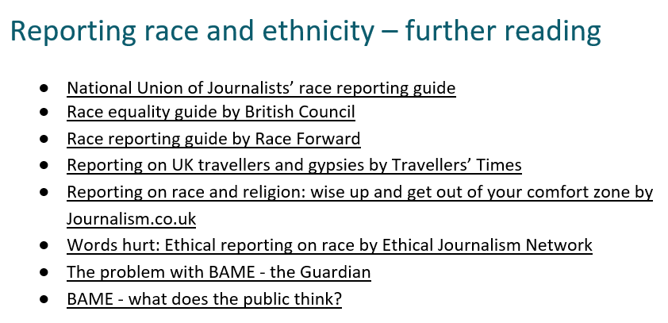
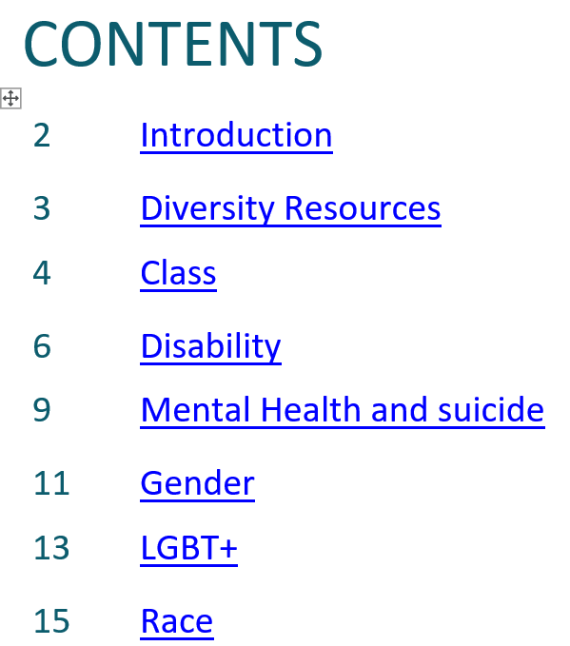
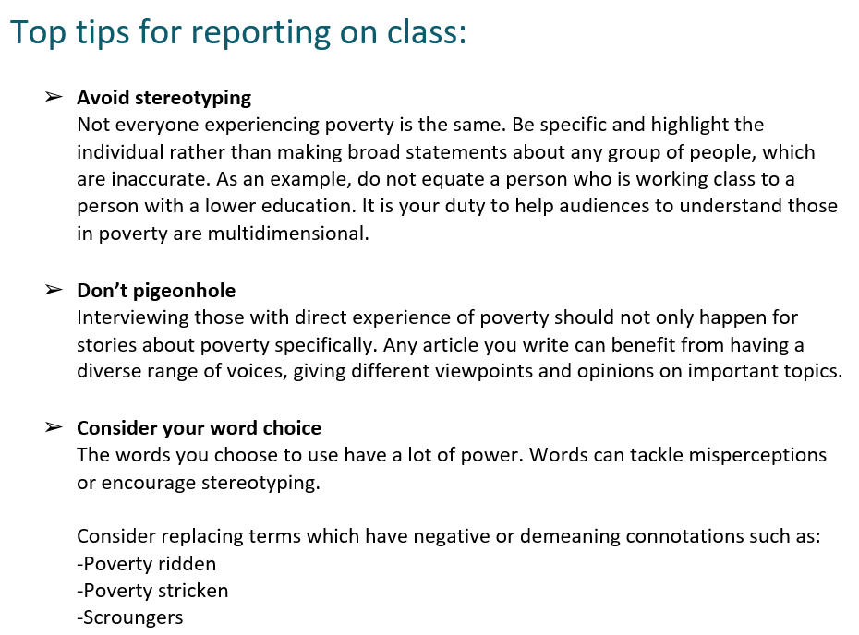
The diversity reporting guide
Diversity, equality and inclusion guide. A practical guide which draws together all of the current thinking on how to report on, and from within, a variety of diverse communities.
Provides links to further reading as well as ‘top tips’ when it comes to inclusive language and reporting advice.
Aimed at giving students confidence, understanding, knowledge and awareness – and providing that key link between the theory and practice.
Student created: written in terms and pitched at a level that works for them

Slide 4
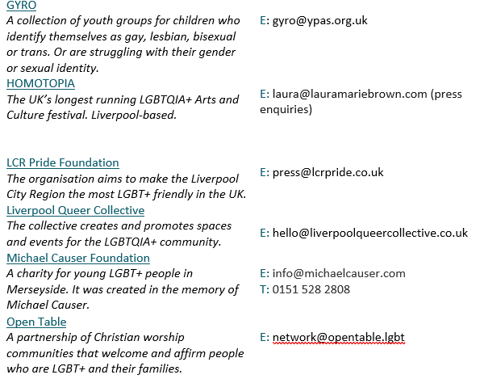
Other student-created resources
Inclusive reporting contacts list for Merseyside
Directory of inclusive journalism examples: journalism about EDI issues and/ or by journalists with lived experience
Directory of practical resources and teaching point examples for journalism/sports journalism tutors to draw on in their day-to-day teaching
Bank of more academic journal articles/textbooks on issues related to EDI in journalism
A ‘wish-list’ of guest speakers
Liverpool ‘infographs’ for L4 and Foundation students
Notes:
featured Elis Palmer, a wheelchair-using broadcast journalist; Becky Davis, an LJMU Journalism graduate and female football reporter, and Kully Khaila, chair of the Royal Television Society Midlands and executive producer of the BBC Academy. Vidar Hjardeng, Diversity Consultant for ITV News; Anna Kessel, founder of Women in Football and now Director of Development for Sky Sports; Rizwana Hamid from the Muslim Council of Britain’s Media Monitoring Project; Hannah Alaja of We are Black Journos.

Slide 5
Embedding the resources
Used in classroom during news days, L5 Journalism Issues module and MA Journalism in Context module
Not presented as perfect or fixed
Starting point for conversations
Initial research for more theoretical modules

Slide 6
student responses
Anecdotally the responses are positive
We ask students to reflect upon their work as an inclusive journalist in some reflections and have input from module evaluation
“learning about journalism in relation to minority groups”
“After looking through…the contacts list…I got in touch with Bradbury Fields, a blindness charity…the person I spoke to was herself blind and offered a fascinating insight into the issue”
“learning how journalism has affected different people differently”
“how UK media can have a positive impact on society as we are so used to hearing about negative”

Slide 7
EVALUATION: EARLY ANALYSIS
Surveyed L5 Journalism and Sports Journalism students at the beginning and end of the year
Asked – “how confident do you feel that you would know the most appropriate and inclusive terminology and language to use if you needed to report on a wide range of diverse communities?”
“Not confident” / “not very confident” – number had fallen
HOWEVER – number “very confident” had halved

Slide 8
Evaluation: analysis
“sometimes you don’t get responses so you go with who you can get”
“I try to include an inclusive range of voices but have failed to do so on some stories”
Students want to do it
They are trying in L5
Easy to become disheartened when it
doesn’t work
“…sometimes it’s hard to attain a range of voices with lack of responses to a media enquiry”

Slide 9
the benefits of co-creation
"I am so grateful I had the opportunity to be a part of this project. Not only has it supported me in my search for employment, but it has provided me with a better understanding of diversity and inclusion that supports me day-to-day in the newsroom. I look forward to seeing how this project continues."
2021 project intern

Slide 10
Lessons learned AND NEXT STEPS
This is a fast-evolving area; languages/ issues change, and the resources need updating
Easy for this to get lost; needs embedding in assessment and learning outcomes sure it gets the space particularly on busy practical/ news day modules
But: how do you reward effort/ awareness if students are trying – so that they don’t feel like a failure
(Some) staff are unsure too
Pragmatic employability benefits: employers have mentioned awareness of EDI
Cross-disciplinary interest in these resources – communication and terminology are key for lots of subjects – but time as ever is an issue

Slide 11
Questions/ comments?
Get in touch:
p.r.sharpe@ljmu.ac.uk
f.h.yeoman@ljmu.ac.uk

