Slide 1
EDI: Actional steps workshop: planning, delivering and assessing Journalism
Dr Gurvinder Aujla-Sidhu
Email: G.Aujla-Sidhu@derby.ac.uk

Slide 2
Workshop overview
Equality, Diversity and Inclusion
Planning curricula
Assessment design
Delivery

Slide 3
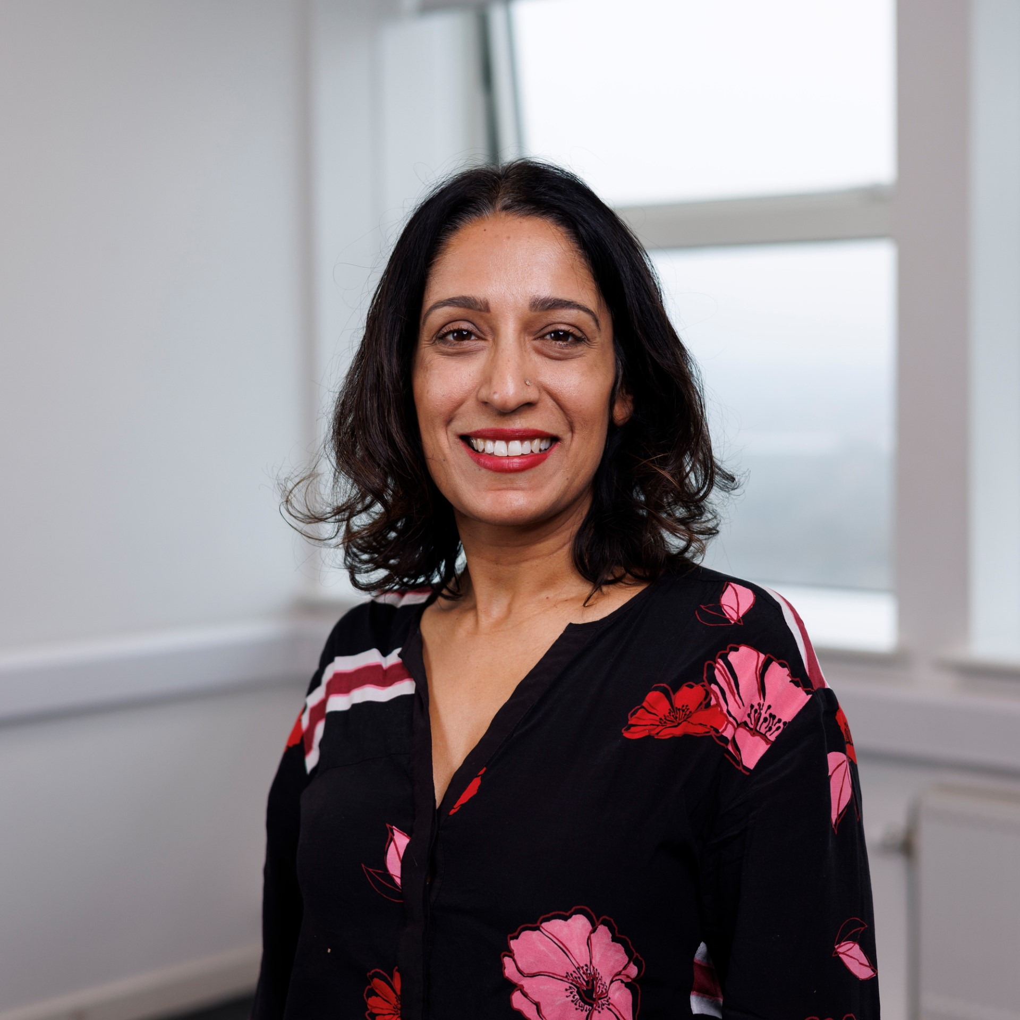
Decolonising DMU
Cannot look at education in isolation. Institutional structures /frameworks impact inequality. Structural inequalities in society, alongside equality and diversity
The 3D Pedagogy Framework (Gabriel, 2019) concentrates upon minority students but impacts and enriches the learning process for students of all ethnic and cultural backgrounds.
Growth in Post 1992 University of BAME students taking either Journalism or Media programmes but this has not necessarily translated as more diversity in the sector.

Slide 4
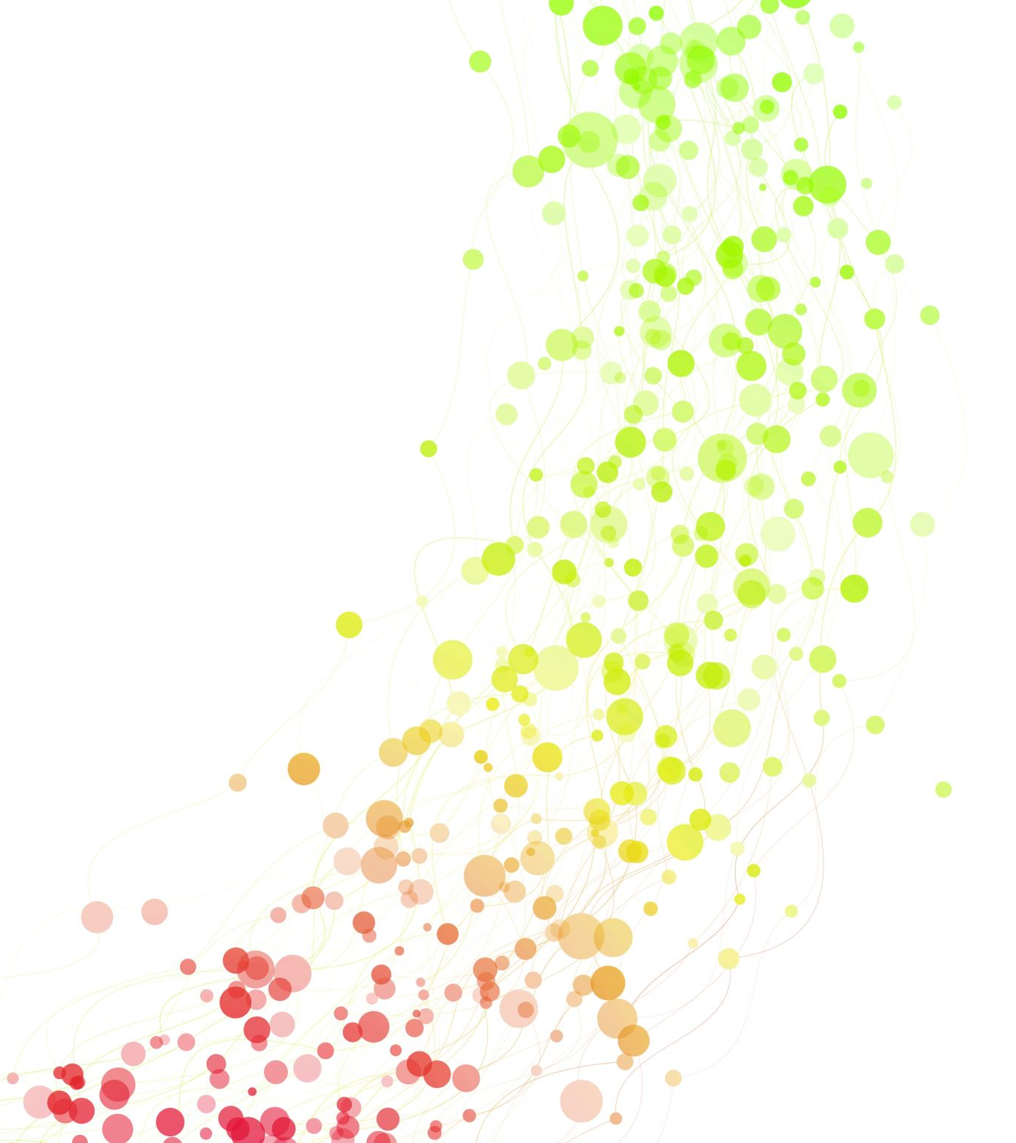
Journalism Education
Educational practitioners have the requisite skills to deliver culturally democratic teaching and create inclusive learning environments in which all students can flourish (Gabriel 2019)
Diversit/EDI are presented as problems
Students need to be reflected: role models, examples, resources and content.
Trainee journalists need learning experiences through interaction with communities, groups and issues. This may challenge their preconceptions.

Slide 5
What worries (if any) do you have about embedding EDI into your curricula?
Secondary title text

Slide 6
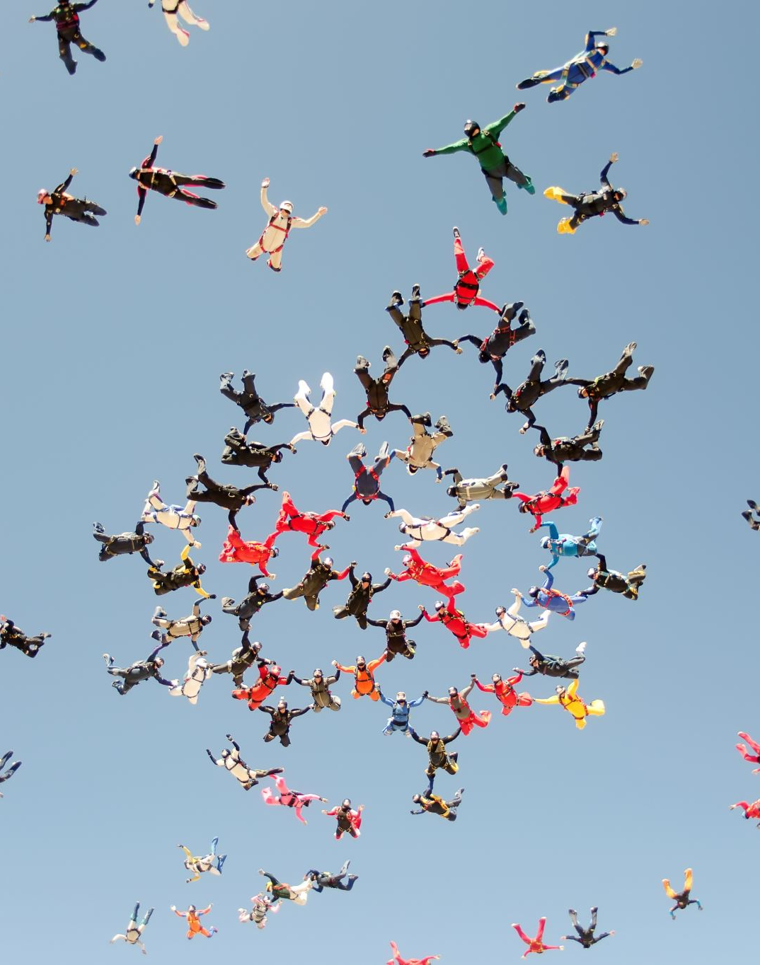
Positionality
The westernized university is a site where learning and the production, acquisition and dissemination of knowledge are embedded in Eurocentric epistemologies that are posited as objective, disembodied and universal and in which non Eurocentric knowledges such as black and indigenous knowledges are largely ignored, marginalized or dismissed.(Cupples and Grosfoguel, 2018)
The curriculum remains largely Eurocentric and continues to reinforce white and western dominance and privilege” Heleta 2016
Cultural competencies for students
Allyship

Slide 7
Exercise 1 : Sense Check where are you now?
Module Content
Reading List and Resources
Employability/Placements
Role-models
Question Prompts
What does your student body in your classroom look like?
What do you actively include counter euro centric theory/views?
What imagery do you seek out for your slides or posters etc?
Which authors are prominent on your reading or slides?
Who offers placements to your students?
Who do you invite in regularly to speak to students?
Do you believe your students feel a sense of belonging on your course?
Example image can be changed in the frame here
Notes:
Pick one of the points and note down what you currently do in terms of diversity/EDI in one area
Use the prompts to help you critically reflect

Slide 8
How do you feel about your Curriculum?
Having reflected on where you currently are - do you feel there specific areas you want to improve?
Do you think your module content reflects the students in your classroom?

Slide 9
Delivering your curriculum
Empowering students –Do they have a space to voice their lived experiences? Are they reflected in your curriculum – resources? Related content, role models?
Does you assessment design offer equality of opportunity for all students? (is it flexible?)
Have you ever reflected upon your individual positionality and what that may mean for your teaching?
Could your content be more culturally diverse?

Slide 10
Practice based ideas
Theme your Newsdays on topical issues ie Sustainability/Social Justice/ International Womens Day/
Who lives in the cities/places where our Universities are located – are their voices being included?
Cover Black issues beyond October
When you invite a guest ask for a woman or someone young, or from a minority background.
Invite back female/ethnic alumni back
Considering a mentoring scheme with your alumni
How can you (or your university) interact with interaction underrepresented communities

Slide 11
Exercise 2 : Assessment Design – Change
Assessment Design
Reading List and Resources
Role-models
Is your assessment flexible?
Do your assessments allow students to bring their lived experiences to the fore?
How can you change your teaching/assessment to promote change?
How can you tackle Whiteness in Journalism
How can you improve gender representation issues in Journalism
How can you embed EDI rather than an odd lecture
who are women or from minority backgrounds.
How does disability feature in your content/assessment
Do you make students audit who they interviewed and why?
Example image can be changed in the frame here
Notes:
Pick one Assessment on a module you teach , consider the reading list and role models as you dissect that assessment
Use the prompts to consider how you can improve it so that students can showcase their cultural competencies in their practical Journalism.

Slide 12
To Finish can you note on the post it notes
2 things you will change in your practice from September 2024
Write them down and stick them on the wall here so we can all see - but then take them back.
This is your postcard to yourself to enhance your student experience on your modules.

Slide 13
Reading and other resources
Decolonizing Journalism Education to Create Civic and Responsible Journalists in the WestAujla-Sidhu, G. (2022)
https://www.tandfonline.com/doi/full/10.1080/1461670X.2022.2096666
Gabriel,D. (2019) Enhancing Higher Education Practice Through the 3D Pedagogy Framework to Decolonize, Democratize and Diversify the Curriculum
https://infonomics-society.org/wp-content/uploads/Enhancing-Higher-Education-Practice-Through-the-3D-Pedagogy-Framework.pdf
Inclusive curriculum Kingston University
https://www.kingston.ac.uk/aboutkingstonuniversity/equality-diversity-and-inclusion/our-inclusive-curriculum/inclusive-curriculum-framework/
Glossary of Terms
https://www.dmu.ac.uk/documents/community/decolonising/glossary-of-key-terms.pdf
https://www.dmu.ac.uk/documents/community/decolonising/decolonising-the-reading-list.pdf
https://www.dmu.ac.uk/community/decolonising/toolkit.aspx
https://libguides.exeter.ac.uk/diversereadinglists

Slide 14
End Slide
University of Derby, Kedleston Road, Derby, DE22 1GB
T +44 (0)1332 591044 E opendays@derby.ac.uk

