Slide 1
Teaching Reporting poverty
Dr Rachel Broady,
Senior Lecturer in Media, Culture, Communication at LJMU

Slide 2
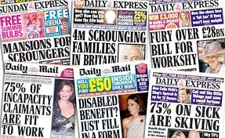
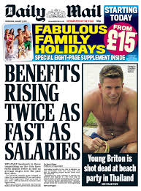
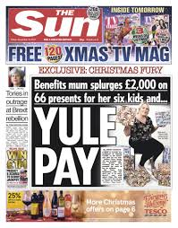
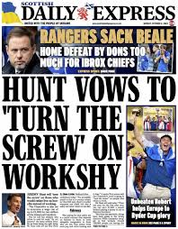
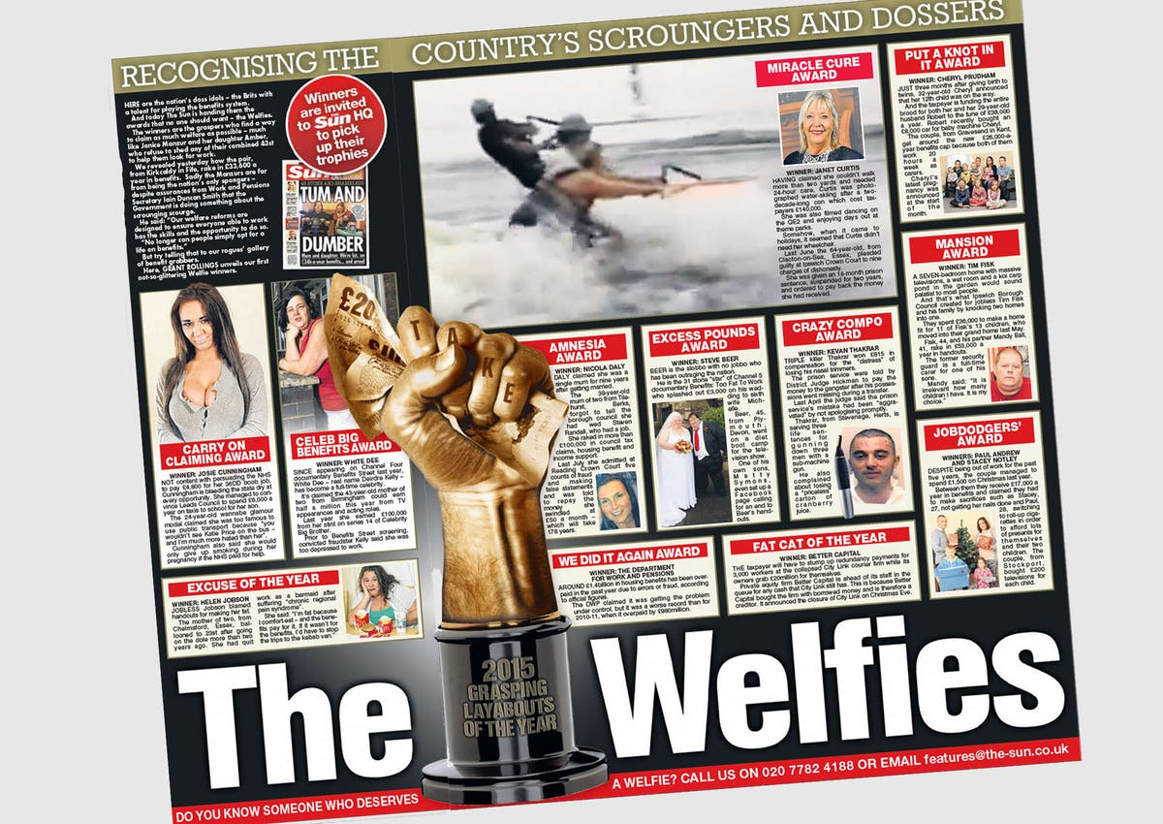
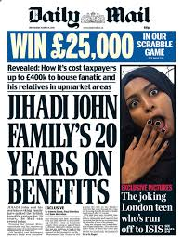
Reporting Poverty
Academic research:
Discourse
Representation
Stereotypes
Stigma
Othering
Policy impact
People in poverty as expert sources

Slide 3
Examining “epistemic injustice” in journalism practice
“a wrong done to someone specifically in their capacity as a knower …”
“… when prejudice causes a hearer to give a deflated level of credibility to a speaker’s words …
… when a gap in collective interpretive resources puts someone at an unfair disadvantage when it comes to making sense of their social experience …”
.
Fricker, M, 2007, Epistemic Injustice Power and the Ethics of Knowing, Oxford University Press, p. 1

Slide 4
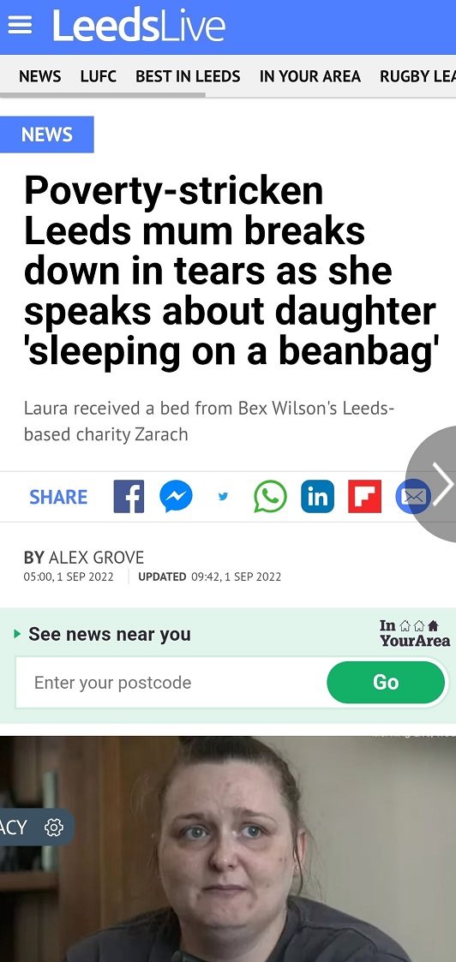
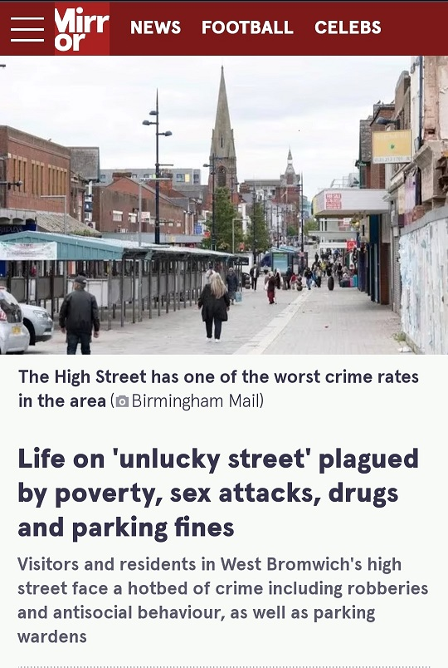
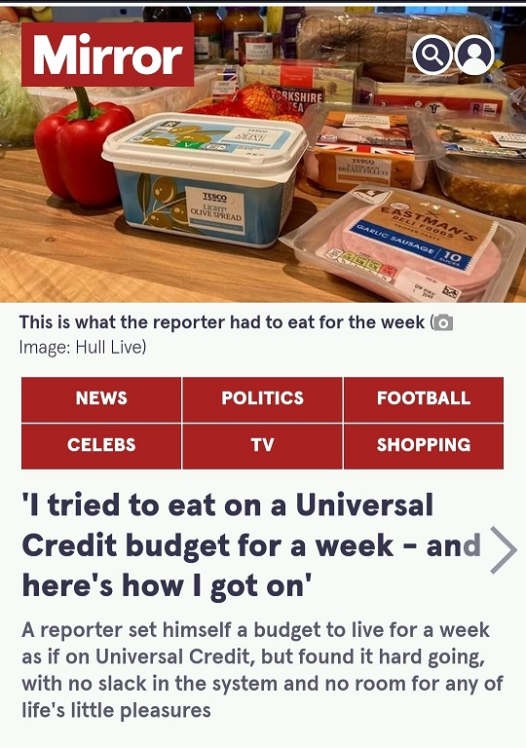
Current practice: Reach publications

Slide 5
The injustice? Reach publications
Observation
Description
Imitation
This suggests those consuming the news don’t already know about poverty or see it themselves.
It sensationalises the experience, presents people in poverty as a threat, limits examination, uses violent language. People not asked about the experience
The mum is observed and not named fully until the fourth paragraph.
The copy depends upon her poverty but is to illustrate a story about a charity.
She’s treated as secondary.
Journalist interprets the experience. Not accurate or real representation. Mediated. Those with direct, relevant experience overlooked.

Slide 6
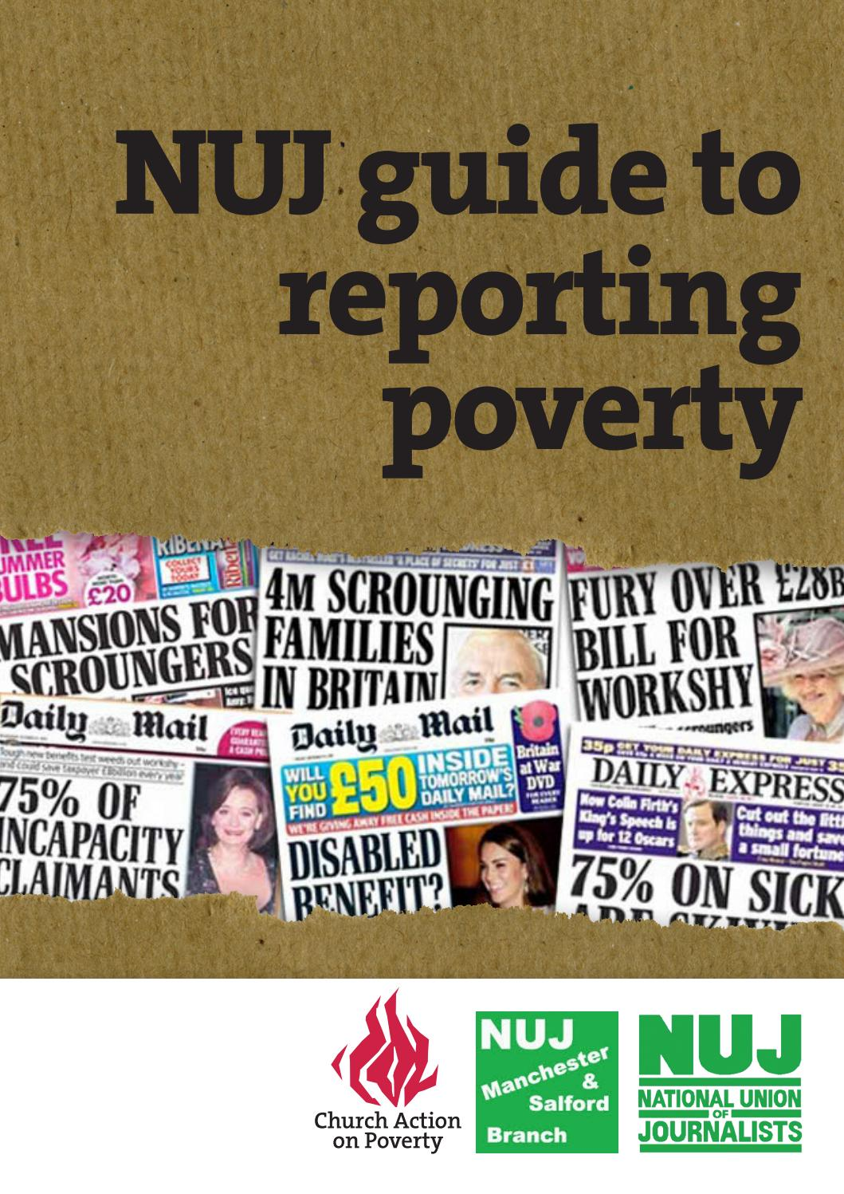
Want to understand poverty? Ask the experts.
But people in poverty are …
Scared of media
Hard to find
Biased
Inarticulate
Unintelligent
Interviewees not case studies
Media trained Human interest & expertise
People in poverty are readers, viewers, listeners
Experienced professionals
Broady, R (2022), NUJ Reporting Poverty campaign: Introducing a trade union challenge to journalistic representations of the unemployed and the working poor, Journal of Class & Culture, 1 (2), pp. 153-171

Slide 7
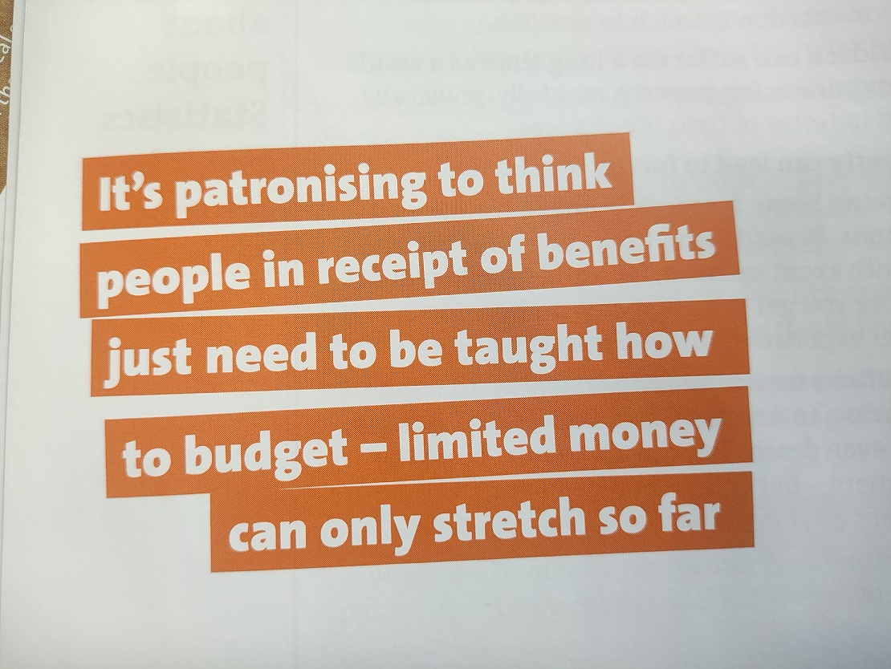
Reporting Poverty Guide
Relevant, valuable, engaging & insightful context

Slide 8
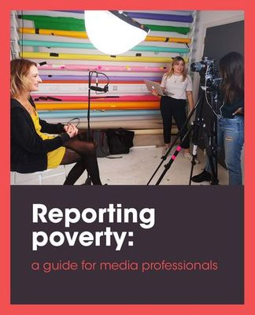
Resources for teaching & practice
People in poverty at organisations such as Church Action on Poverty receive media training.
Better story – more detail, development beyond observe, describe, imitate approach.
Contribute to eradication of poverty by removing an obstacle in which media sees people in poverty as other and disempowers them.
Can influence policy-change and political responses: not justify benefit cuts through dehumanising language.
On NUJ website under resources

Slide 9
THANK YOU
I can provide a copy of the original NUJ guide on request
Rachel Broady
r.s.broady@ljmu.ac.uk
reportingpoverty.com

