Slide 1



Bringing Student Voice to Evaluation:
Using Q Methodology for Creating a Student-led Question Bank
Dr Anna Law, Dr Elena Zaitseva
Liverpool John Moores University

Slide 2
Presentation outline
Project background
Aims of the project
Q Methodology
Outcomes of the project
Evaluation of staff perceptions
Q Methodology research outcomes
Future steps

Slide 3
“The module evaluation questions are not relevant…”
  Workshops for course reps explored student views on the existing institutional surveys and how student voice could be strengthened
  Module evaluation questions, although clear/non-ambiguous, were perceived by many reps as non-relevant
  Some students used free text comments to comment on topics that were deemed important, others ‘didn’t bother’
  5 core questions; staff question banks and self-written questions have been used by 30% of module leaders – ‘question personalisation’

Slide 4
Literature
Surveys rarely, if ever, provide a nuanced understanding of student concerns, issues and acknowledgements (Harvey, 2003)
When student feedback is disconnected from the everyday practice of students, it presents limited perspectives of respondents, students become more cynical and information less valid and reliable (Darwin, 2010)
Survey creators should consider tailoring survey content to what students themselves consider to be highly important and be sensitive to student learning (Scott, 2006; Harvey, 2011, Tucker et al, 2013).

Slide 5

Explorance’s Faculty Research Grant Program
Successfully applied for a grant for Blue Explorance Users: https://explorance.com/blog/explorances-faculty-research-grant-program/
Resources for:
Employing four student-researchers for four months
  Our thanks to: Oghenefe Otobrise, Karston Wood, Kay Biela & Michael Johnson
Incentives for participants of the research
Dissemination of the findings

Slide 6
Aims of the project
Make the student voice central in the institutional module evaluation survey by developing a student-led question bank (SQB); use it in Semester 2 survey
Raise academic staff awareness of student priorities
Use the project and its output (SQB) as a vehicle for student engagement in module evaluation
Explore key factors and different patterns of thoughts about module level experience; identify groups of students with similar opinions

Slide 7
Q Methodology
Invented in 1935 by British physicist-psychologist William Stephenson
Combines the strengths of both qualitative and quantitative research traditions
Particularly suitable for researching diversity of subjective experiences, perspectives, and beliefs
The methodology is based on correlation and factor analysis of the ranked statements, and interpretation is supported by participant commentaries while doing the sorting exercise.
Can facilitate the identification of similarities and construction of broad categories of the phenomenon being investigated

Slide 8
Project stages
Stage 1: gathering opinion statements
4 focus groups facilitated by student- researchers and exploring students’ module level experience and priorities in module evaluation
Outcome: a q-set of items/statements (60) that students would want to include in module evaluation.
Stage 2: sorting exercise (Q-sort)
4 workshops with a different set of students, sorting the statements along a continuum of preference and providing comments on the statements (post-sort-interviews)
Stage 3: data input and selection of ‘most relevant’ questions for inclusion in SQB
Stage 4: research (a dedicated Q software package is used to identify factors that can represent shared forms of understandings among participants)

Slide 9
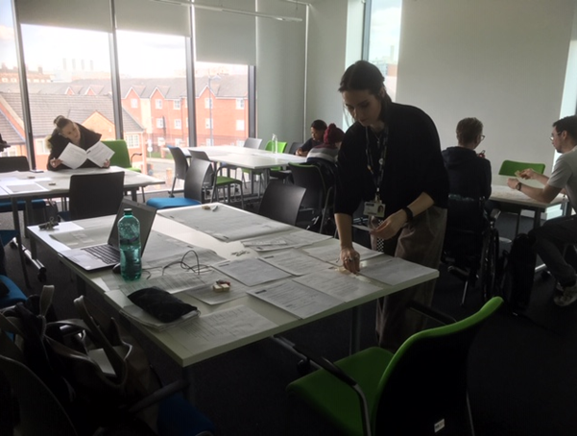
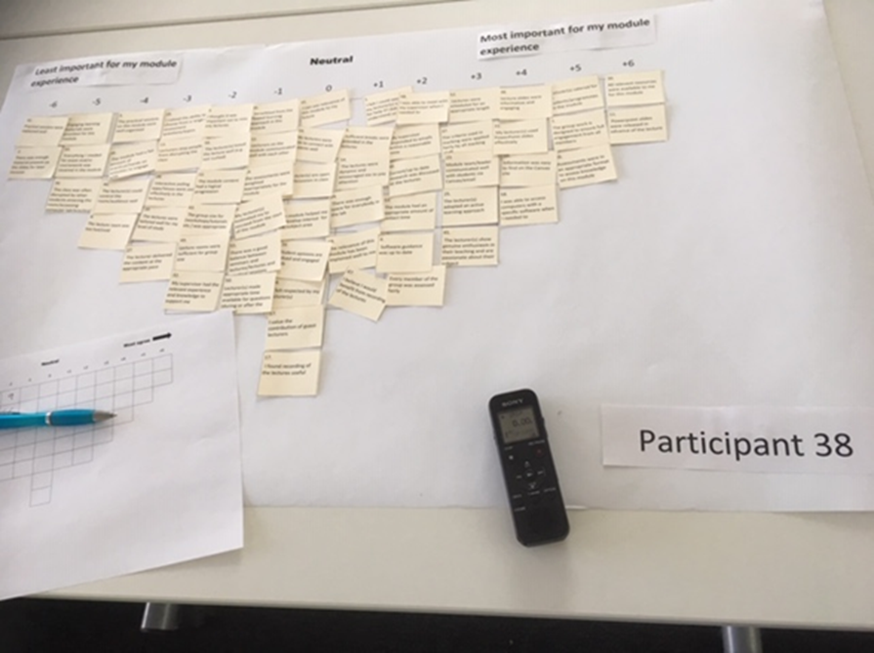

Slide 10
Main themes raised by students
1. Teaching delivery (pace of delivery, usability of PowerPoint slides, pitched at the right level, ability to motivate, suitability of material for all students in multi-programme modules, logical progression of content etc.)
2. Organisation and communication (clear/detailed module guide, consistent communication of information and advice from staff, teaching/learning materials up to date and easy to find, organisation of practical sessions, interaction outside of taught sessions)
3. Learning Environment (disruptions, sufficient breaks, groups size, length of lectures, staff being able to control the audience).
4. Student support and feeling valued and respected (approachable lecturers, student opinions being valued)
Less frequent themes: assessment, learning resources, group work, attendance
No discourse related to skills development and feedback on student work (e.g., quality of feedback, ability to use it to improve, etc.).

Slide 11
Student Question Bank

Slide 12
Usage of the SQB
303 module leaders out of 1193 used QP in their module evaluation (25% of all staff)
Out of 303, 87% used questions from the SQB
Overall, student questions were used across 814 different modules
Most frequently used questions:

Slide 13
Evaluation of staff perceptions: Survey
Survey sent to all module leaders who chose at least one question from the SQB
  39 respondents
Modules spread equally across undergraduate years 1-3, fewer postgraduate
87% had personalized their surveys with additional items previously
  But 56% were unaware that the answers would not count to overall module score
74% found the feedback from the student-generated items useful (10% unsure)
  But only 26% intended to make module changes based on the feedback (26% unsure)

Slide 14
Evaluation of staff perceptions: Interview
Interviews with 6 members of staff who used SQB
  Highly motivated to use feedback, positive about SQB, but acknowledged barriers for colleagues
“I think the student question bank should continue and it should be part of module evaluation. But I think the students themselves need to have their own form of evaluation, and that they should also be evaluating their own performance as anyone does in the workplace.” – Participant 6
“I consider it is very successful in in terms of the data that it generates and the ability to give you a bit more insight into elements of the module that you potentially see as not the best” - Participant 4
“Staff may have to be quite brave to select some of the student questions {from question bank} as they may be quite threatening to them.” – Participant 5
“And what we’ve tried to do is to debrief it, look where its poor, try to improve things.” – Participant 3

Slide 15
Q Methodology research outcomes
The Q-sort results were analysed using PQ Method software
Principal component analysis and varimax rotation, followed by classification of participants by the number of load factors. 3 Factors were identified/analysed.
Partial table of Factor Scores for Factor 1
No. | Statement | Z-SCORES
60 | Everything I needed for exam and/or coursework was covered… | 2.262
42 | Practical sessions were explained well | 1.907
1 | I could approach my lecturer and ask for help if I didn’t understand…. | 1.720
58 | I was able to access computers with a specific software when | 1.379

Slide 16
Q Methodology: research outcomes
Partial Factor Matrix with an X Indicating a Defining Sort Loadings
Q SORT | Factor 1 | Factor 2 | Factor 3
1. Participant 20 | 0.5131X - | -0.3898 | 0.0825
2. Participant 28 | 0.5291X | 0.2402 | -0.2314
3. Participant 30 | 0.0998 | 0.5839X | 0.0903
4. Participant 39 | 0.2715 | 0.2704 | -0.1674
5. Participant 18 | 0.3382X | 0.1469 | 0.2985
6. Participant 25 | 0.6896X | -0.1287 | 0.2964
……….

Slide 17
Factor 1: Structured and guided module experience
Eigenvalue is 4.3; explains 14% of the study variance.
22 distinguishing statements loaded on this factor (significance at p < 0.01.)
11 students were significantly associated with this factor (predominantly Level 4 and 5 students, Humanities & Social Sciences and Engineering and Technology, approx. equal gender split)
Young/traditional students, who are trying to develop interest in the subject area
Value structured content (directly liked to exams) and well-defined learning experience
Tend to rely on resources/guidance provided
Approachability of staff and support provided are appreciated
More concerned with fairness of assessment and teamwork contribution than other groups - indicators of lacking confidence/feeling unsecure?
Show signs of extrinsic motivation

Slide 18
Factor 2: Maximising learning experience
Eigenvalue is 2.7; 9% of the study variance explained (26 distinguishing statements)
6 students are associated with this Factor (predominantly Level 6, Humanities & Social Sciences, Health, Business, equal gender split)
Motivated and highly engaged students; well developed interest in the subject area
Value interaction with staff (in class and outside) and clear communication; engaging delivery is also appreciated.
They appreciate ability to choose from a range of assessments
Want to have access to slides prior to the lecture and to recordings afterwards, and have all necessary resources provided on Canvas
Not particularly concerned about group work (e.g. unequal workload) and fairness of assessment
Confident learners demonstrating cognitive effort and strategic approach, aiming to maximise learning experience.

Slide 19
Factor 3: Settling into a culture of research and scholarship
Eigenvalue is 2.4; 8% of the study variance explained (23 distinguishing statements)
8 Students associated with this factor (mainly level 7 and 6, few level 5, Engineering and Technology, Science and Health, 5 female, 3 male)
This group of students spans various levels of study, but main trends are:
This group is concerned with successful completion of dissertation/final year project (want their supervisor being an expert in the subject area and their queries to be answered promptly)
Being motivated from the start of the module is more important for this group than for others
They appreciate when relevance of what they learn is explained/reinforced
Importance of material being tailored to their level of study and logical progression of the material For these students feeling respected by their lecturers is also imperative.
Value the contribution of guest lecturers, current up to date research being discussed

Slide 20
Next Steps
Engage in wider promotion of the SQB, for both staff and students
Complete and disseminate study findings:
  Internally at the Teaching and Learning conference and at the Research and Practice Seminar
  Externally through research publications and next Bluenotes Global??

Slide 21
References
Watts, S. & Stenner,P. (2012) Doing Q Methodological Research: Theory, Method and Interpretation http://methods.sagepub.com/book/doing-q-methodological-research
Darwin, S. (2010) Exploring critical conceptions of student-led evaluation in Australian
higher education. In M. Devlin, J. Nagy and A. Lichtenberg (Eds.) Research and Development
in Higher Education: Reshaping Higher Education, Melbourne, 33, pp. 203–212.
Harvey, L. (2003). Student feedback [1]. Quality in Higher Education, 9(1), pp. 3-20.
Harvey, L. (2011) The nexus of feedback and improvement. In C. S. Nair, & P. Mertova (Eds.) Student feedback the cornerstone to an effective quality assurance, Oxford, UK: Woodhead Publishing.
Scott, G. (2006) Accessing the student voice: using CEQuery to identify what retains students and promote engagement in productive learning. In Australian Higher Education. Canberra: Department of Education, Science and Training. Available online: https://www.uws.edu.au/__data/assets/pdf_file/0010/63955/HEIPCEQueryFinal_v2_1st_Feb_06.pdf
Tucker, B., Oliver, B. & Gupta, R. (2013) Validating a teaching survey which drives increased response rates in a unit survey, Teaching in Higher Education, 18(4), pp. 427-439

